Slide 1

GraphQLite workshop

Slide 2
GraphQLite workshop
What is GraphQL?
GraphQL type system
The GraphQL ecosystem in PHP
GraphQLite

Slide 3




« me »
We are hiring!
David Négrier
aka:
CTO & co-founder @TheCodingMachine
PSR-11 co-editor
GraphQLite author
But also Packanalyst, Mouf, TDBM…
moufmouf
@david_negrier
joind.in/user/moufmouf

Slide 4
Setting up your environment

Slide 5
Setting up the test project
Download
Or copy the project from a USB key (better!)
http://bit.ly/phpuk-graphqlite

Slide 6






Our test project
Today, we will work on a marketplace!
For this demo, our stack will be:
Symfony
Doctrine ORM
GraphQLite
Docker
React
Apollo

Slide 7

Our test project
From Github
From a USB key (no network connection)
$ docker-compose up
(Beware, there is a 500MB download!)
Copy files
Run
$ ./install-images.sh
(or install-images.bat)
Unzip project:
$ unzip graphqlite-demo-phpuk.zip
Start project:
$ docker-compose up
Install Altair GraphQL client

Slide 8

Our test project
If you downloaded from Github:
From a USB key:
$ docker-compose up
Copy files
Run
$ ./install-images.sh
(or install-images.bat)
Then
$ docker-compose up

Slide 9
GraphQLite workshop
What is GraphQL?
GraphQL type system
The GraphQL ecosystem in PHP
GraphQLite

Slide 10

GraphQL ?
GraphQL is a protocol

Slide 11
GraphQL ?
GraphQL is a protocol
It is not:
A fancy new database
A database query language like SQL

Slide 12
GraphQL ?
GraphQL is a protocol
GraphQL is a challenger to those other protocols:
REST
Web-services (SOAP/WSDL based)

Slide 13
A bit of history
Web-services (~1999)
✓ Strongly typed
✓ Self-describing (WSDL)
✗ XML-based

Slide 14

A bit of history
Web-services (~1999)
✓ Strongly typed
✓ Self-describing (WSDL)
✗ XML-based

Slide 15
A bit of history
Web-services (~1999)
REST (~2005)
✓ Strongly typed
✓ Self-describing (WSDL)
✗ XML-based
✗ Weakly typed
✗ Non self-describing (still OpenAPI for doc)
✓ Mostly JSON based

Slide 16

A bit of history
Web-services (~1999)
REST (~2005)
✓ Strongly typed
✓ Self-describing (WSDL)
✗ XML-based
✗ Weakly typed
✗ Non self-describing (still OpenAPI for doc)
✓ Mostly JSON based

Slide 17
A bit of history
Web-services (~1999)
REST (~2005)
GraphQL (2015)
✓ Strongly typed
✓ Self-describing (WSDL)
✗ XML-based
✗ Weakly typed
✗ Non self-describing (still OpenAPI for doc)
✓ Mostly JSON based
✓ Strongly typed
✓ Self-describing
✓ JSON based
✓ ✓ + Client driven queries

Slide 18


A bit of history
SOAP/WSDL
REST
GraphQL

Slide 19
GraphQL ?
It is developed by Facebook and was first used in the Facebook API.
It is now an open protocol backed by the GraphQL foundation.

Slide 20
Why GraphQL?

Slide 21
What problem does GraphQL solve?
Your API often changes
Common problems:
You develop a new feature but your API does not exactly respond to your needs.
Each time you consume your API on the frontend, you need to change it in the backend

Slide 22
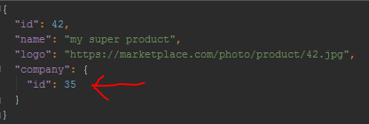
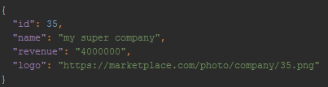
What problem does GraphQL solve?
For instance: you are developing a marketplace. You need a page to display a product, along some company information.
REST
/api/product/42
/api/company/35

Slide 23
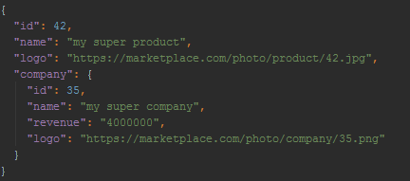
What problem does GraphQL solve?
Alternative, still REST
But what if some pages don’t need the company details?
/api/product/42
REST

Slide 24
What problem does GraphQL solve?
Yet another alternative, still REST
/api/product/42?with_company=true
Flags hell 😨! Probably one flag per consumer of the API
REST

Slide 25
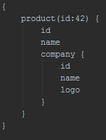
What problem does GraphQL solve?
GraphQL to the rescue!
GraphQL is a paradigm shift.
The client asks for the list of fields it wants.
GET /graphql?query=
Single endpoint
The name of the query is « products »
List of fields requested

Slide 26
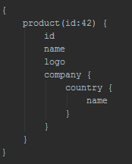

What problem does GraphQL solve?
GraphQL to the rescue!
Another request of the same query with a different set of fields
GET /graphql?query=
No need to change the code on the server-side! All this data in one API call!

Slide 27
GraphQLite workshop
What is GraphQL?
GraphQL type system
The GraphQL ecosystem in PHP
GraphQLite

Slide 28
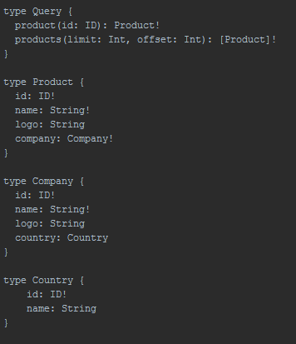
Types
GraphQL is strongly typed.
It comes with a « schema language » but this is rarely used while developing.
It is however useful to understand what is going on.

Slide 29
Query language
Schema language
product(id: 42) { name company { name logo country { name } } }
≠

Slide 30
Types
Note:
[Product] ➔ an array of Products
String ➔ a string (or null)
String! ➔ a non-nullable string
Hence:
[Product!]! ➔ An array (non-nullable) of products that are also non-nullable.

Slide 31
Types
Some « scalar » types:
ID: a unique identifier (~=String)
String
Int
Float
Boolean
No support for « Date » in the standard (but custom types are supported by some implementations)

Slide 32
Types
Support for “arguments”:
product(id: ID!) ➔ the product query requires an “id” field of type “ID” to be passed.

Slide 33
Types
Bonus:
Support for interfaces
Support for Union types
Support for “InputType” (to pass complex objects in queries)

Slide 34
Mutations
So far, we mostly talked about queries (because this is what is fun in GraphQL).
GraphQL can also do mutations (to change the state of the DB)

Slide 35
GraphQLite workshop
What is GraphQL?
GraphQL type system
The GraphQL ecosystem in PHP
GraphQLite

Slide 36
Ecosystem (a small part of…)
Browser
Server
ReactJS
RelayJS
express-graphql
Apollo server
NestJS
NodeJS
Full featured clients
Apollo
Webonyx/ GraphQL-PHP
API Platform
Overblog GraphQL-Bundle
PHP
GraphQL
Playground
Altair
GraphiQL
Lighthouse
GraphQLite
…
Dev clients

Slide 37
Zoom on GraphQL in PHP
Core library
Wrapper library
Low level
Parsing
Serving requests
Powerful
Feature complete
Hard to use (poor DX)
High level
Opiniated
Easy to use

Slide 38
Zoom on GraphQL in PHP
Core library
Wrapper library
webonyx/graphql-php
De-facto standard in PHP
Youshido/GraphQL
☹ Abandonned ☹
Railt
In active development, no solid doc yet

Slide 39
Zoom on GraphQL in PHP
Core library
Wrapper library
API Platform (Symfony)
Overblog GraphQL Bundle (Symfony)
Lighthouse (Laravel)
getpop/graphql (Wordpress)
drupal/graphql (Drupal)
… and now GraphQLite

Slide 40
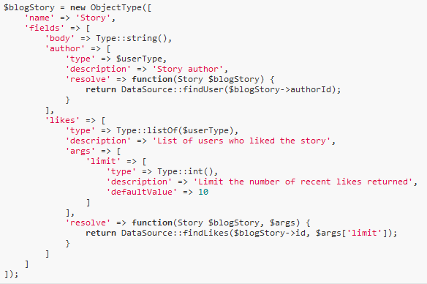
Zoom of Webonyx/GraphQL-PHP
Define a type
This code will generate this type:
type Story {
body: String
author: User
likes(limit: Int): [User]
}

Slide 41
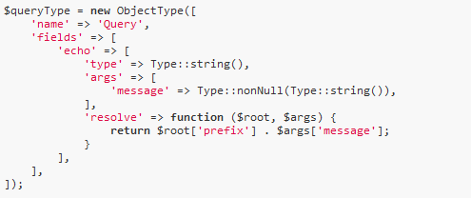
Zoom of Webonyx/GraphQL-PHP
Define a query
This code will generate this query:
type Query {
echo(message: String!): String!
}

Slide 42
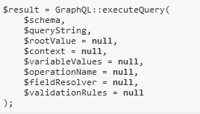
Zoom of Webonyx/GraphQL-PHP
Actually resolving a query

Slide 43
Costs VS benefits
Costs
Gains
Client driven
Self-described
Work
Strict types

Slide 44

You need a wrapper library
Costs
Gains
GraphQL library
Client driven
Work
Self-described
Strict types

Slide 45
Strategies
Schema-first
Code-first
Design the GraphQL schema first
Find a way to link it to your code
Design your domain code
Generate the schema from the code
Notes:
Note: similar to WSDL tools

Slide 46
Strategies
Schema-first
Code-first
Overblog GraphQL Bundle
Lighthouse
Railt
getpop/graphql
API Platform
GraphQLite
Notes:
Note: similar to WSDL tools

Slide 47
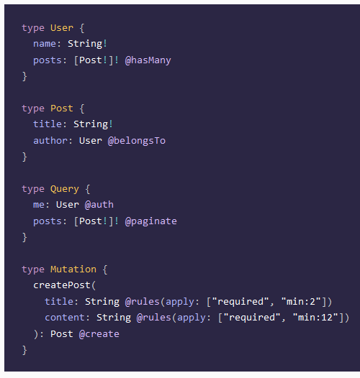
Schema-first: Lighthouse (Laravel)
Define the GraphQL schema first
Annotate the schema with “directives”
The directives are binding the schema to Eloquent directly
Notes:
Very tied to Eloquent
Has support for subscriptions
Notes:
Note: similar to WSDL tools

Slide 48
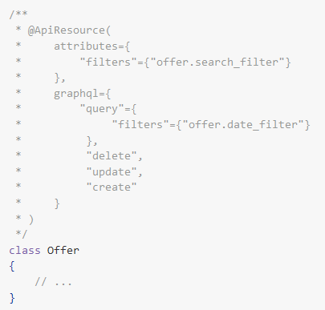
Code-first: API Platform (Symfony)
Annotate your classes
The GraphQL schema is generated from the annotations
“REST” philosophy at the core of API Platform
Notes:
Great if you want both a REST and a GraphQL API (you code it only once)
Harder if you want fine grained control on the GraphQL schema
Support for subscriptions is coming
Notes:
Note: similar to WSDL tools

Slide 49
Picking a GraphQL library (disclaimer: probably biased view)
Are you developing an app or a tool?
Overblog GraphQL Bundle
Lighthouse
Railt
getpop/graphql
API Platform
GraphQLite
Webonyx Railt
dynamic
static
Are your models static or dynamic?
Notes:
Note: similar to WSDL tools

Slide 50
Picking a GraphQL library (disclaimer: probably biased view)
Do you need subscriptions?
Lighthouse
API Platform Webonyx
Any library
no
yes
Notes:
Note: similar to WSDL tools

Slide 51
Picking a GraphQL library (disclaimer: probably biased view)
Do you want Relay / React compatibility?
Lighthouse
Overblog/GraphQL-bundle Webonyx
Any library
no
yes
Notes:
Note: similar to WSDL tools

Slide 52
Picking a GraphQL library (disclaimer: probably biased view)
What framework do you use?
API Platform Overblog/GraphQL-bundle Webonyx GraphQLite
Lighthouse Webonyx GraphQLite
Symfony
Laravel
Other
Webonyx GraphQLite
Notes:
Note: similar to WSDL tools

Slide 53
Picking a GraphQL library (disclaimer: probably biased view)
Do you prefer schema first or code first?
Overblog GraphQL Bundle
Lighthouse
Railt
Schema first
Code first
API Platform
GraphQLite
Notes:
Note: similar to WSDL tools

Slide 54
GraphQLite workshop
What is GraphQL?
GraphQL type system
The GraphQL ecosystem in PHP
GraphQLite

Slide 55
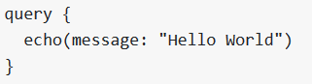
The idea
Let’s imagine we want to do a simple “echo” query in PHP.

Slide 56
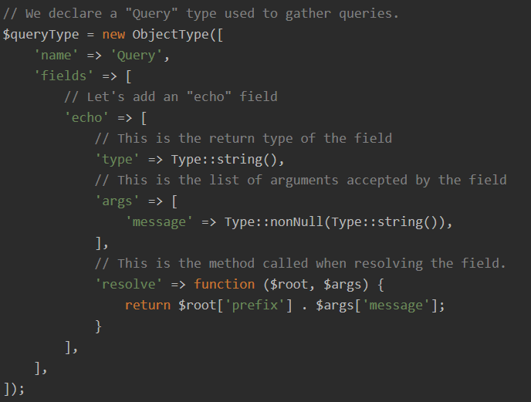
The idea
Using webonyx/GraphQL-PHP
type Query { echo(message: String!): String }

Slide 57
The idea
The same “echo” method in pure PHP
function echoMsg(string $message): string { return $message; }

Slide 58
The idea
The same “echo” method in pure PHP
Return type
Arguments
Query name
function echoMsg(string $message): string { return $message; }
Resolver

Slide 59
The idea
The same “echo” method in pure PHP
/** * @Query */ function echoMsg(string $message): string { return $message; }

Slide 60
The idea
PHP is already typed.
We should be able to get types from PHP and convert them to a GraphQL schema
GraphQLite
PHP objects
GraphQL objects

Slide 61
Works well with Doctrine
Bonus:
It plays nice with Doctrine ORM too
(it also plays nive with Eloquent and TDBM)
Doctrine
GraphQLite
DB model
PHP objects
GraphQL schema

Slide 62
GraphQLite
GraphQLite is:
Framework agnostic
Symfony bundle and Laravel package available
PHP 7.2+
Based on Webonyx/GraphQL-PHP

Slide 63
Hands on time!
Getting started
Pagination
Authentication / Authorisation
Autowiring
The front-end side
Mutations
Performance

Slide 64
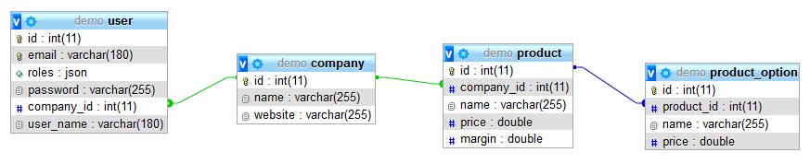
Our playground: a marketplace!

Slide 65
Our playground
A call to “docker-compose up” will:
Run “composer install”
Initialize the DB model
Fill the DB model with test data
You can therefore restart the environment at any point to reset the database.

Slide 66
Our playground
Available endpoints:
http://localhost:81 ➔ Symfony
http://localhost:82 ➔ PhpMyAdmin
http://localhost:83 ➔ Svelte front-end
http://localhost:84 ➔ React front-end

Slide 67

MEET OUR PO
HE WANTS HIS MARKETPLACE DONE. FAST.

Slide 68
First query
namespace App\GraphqlController; use App\Entity\Company; use App\Repository\CompanyRepository; use Porpaginas\Doctrine\ORM\ORMQueryResult; use TheCodingMachine\GraphQLite\Annotations\Query; class CompanyController { /** * @var CompanyRepository */ private CompanyRepository $companyRepository; public function __construct(CompanyRepository $companyRepository) { $this->companyRepository = $companyRepository; } /** * @Query() */ public function getCompanies(?string $search) { return $this->companyRepository->search($search)->getResult(); } }

Slide 69
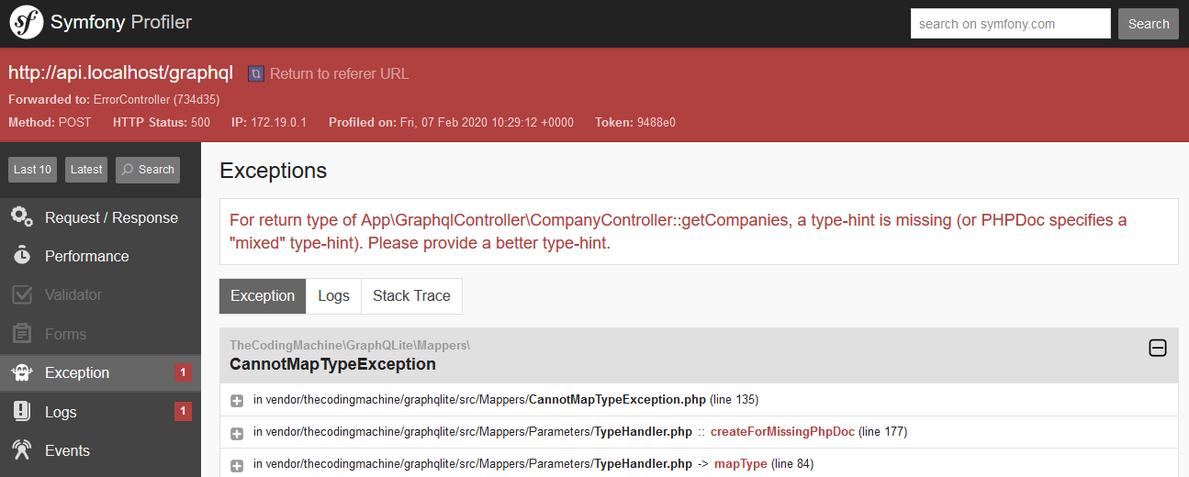
First query

Slide 70
First query
namespace App\GraphqlController; use App\Entity\Company; use App\Repository\CompanyRepository; use Porpaginas\Doctrine\ORM\ORMQueryResult; use TheCodingMachine\GraphQLite\Annotations\Query; class CompanyController { /** * @var CompanyRepository */ private CompanyRepository $companyRepository; public function __construct(CompanyRepository $companyRepository) { $this->companyRepository = $companyRepository; } /** * @Query() * @return Company[] */ public function getCompanies(?string $search): array { return $this->companyRepository->search($search)->getResult(); } }

Slide 71
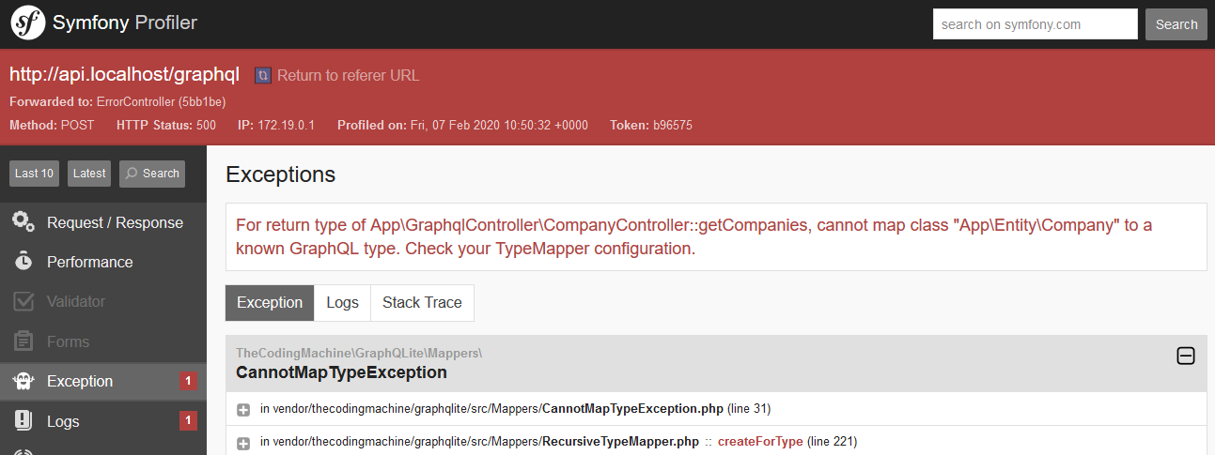
First query

Slide 72
<?php namespace App\Entity; use TheCodingMachine\GraphQLite\Annotations\Field; use TheCodingMachine\GraphQLite\Annotations\Type; /** * @Type() * @ORM\Entity(repositoryClass="App\Repository\CompanyRepository") */ class Company { /** * @Field() */ public function getId(): ?int { return $this->id; } /** * @Field() */ public function getName(): ?string { return $this->name; } /** * @Field() */ public function getWebsite(): ?string { return $this->website; }

Slide 73
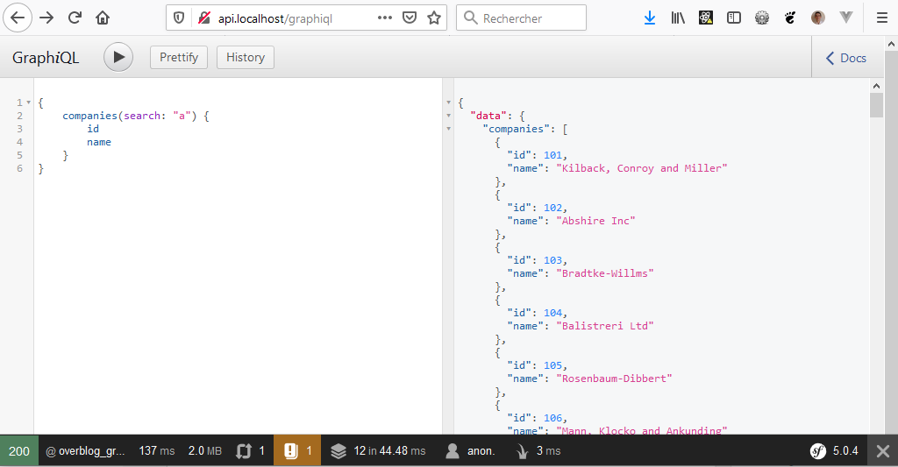
First query

Slide 74
First query
/** * @Type() */ class Company { // …
/** * @Field() * @return Product[] */ public function getProducts() { return $this->products; }
}

Slide 75
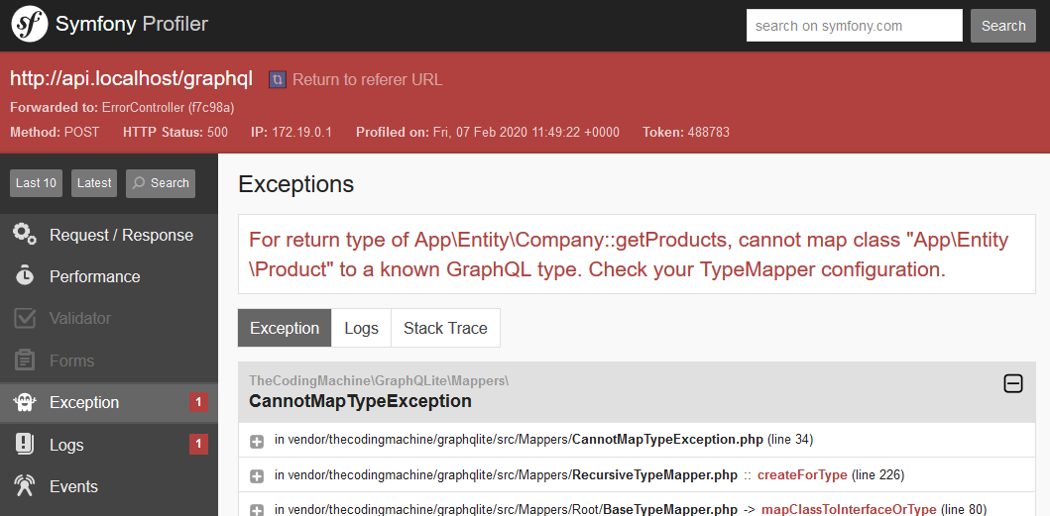
First query

Slide 76
First query
<?php namespace App\Entity; use TheCodingMachine\GraphQLite\Annotations\Field; use TheCodingMachine\GraphQLite\Annotations\Type; /** * @Type() */ class User implements UserInterface { // … /** * @Field(outputType="ID!") */ public function getId(): int { return $this->id; } /** * @Field() */ public function getLogin(): string { return $this->login; } // …

Slide 77
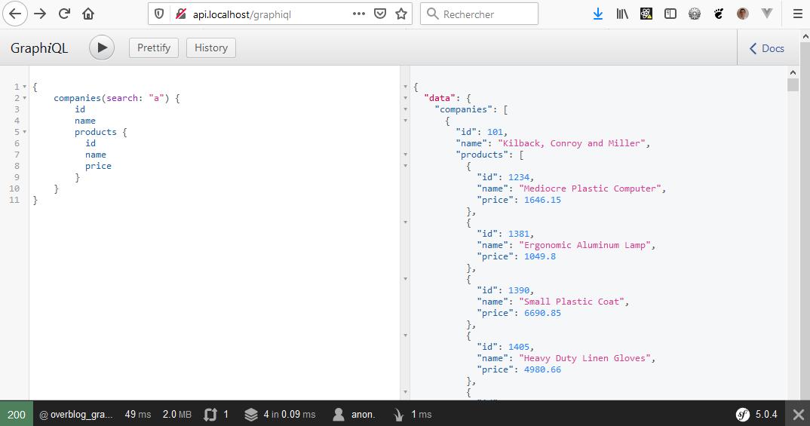
First query

Slide 78

MY LIST OF COMPANIES IS HUGE!
GIVE ME PAGINATION! NOW!

Slide 79
Hands on time!
Getting started
Pagination
Authentication / Authorisation
Autowiring
The front-end side
Mutations
Performance

Slide 80
Pagination using input arguments
/** * @Query() * @return Company[] */ public function getCompanies(
?string $search,
int $limit = 100,
int $offset = 0) { // ... }
Since we can pass any argument in a function, it is quite easy to add a “limit” and an “offset” parameters:

Slide 81
Native pagination
Actually, you don’t even have to bother adding pagination as GraphQLite integrates natively with Porpaginas.
Porpaginas is a generic pagination interface.
(and Porpaginas integrates with Doctrine queries)

Slide 82
Native pagination
use Porpaginas\Doctrine\ORM\ORMQueryResult; class CompanyController { /** * @Query() * @return ORMQueryResult|Company[] */ public function getCompanies(?string $search): ORMQueryResult { return new ORMQueryResult($this->companyRepository->search($search)); } }

Slide 83
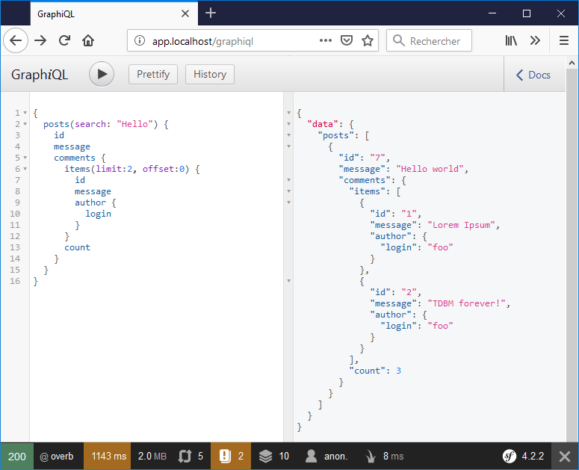

Slide 84
Hands on time!
Getting started
Pagination
Authentication / Authorisation
Autowiring
The front-end side
Mutations
Performance

Slide 85
Authentication
mutation login { login(
userName:"user1@example.com",
password:"password") { userName } }
GraphQLite – Symfony integration comes with 3 operations:
“me” query
“login” mutation
“logout” mutation
You can use those as soon as Symfony security is setup.
query me { me { userName roles } }

Slide 86
Authentication
UserInterface
The “me” query returns a Symfony “UserInterface”
Therefore, you cannot directly access the “company” or the “email” field from the “me” query
- getUsername - getRoles
User
- getCompany
- getEmail

Slide 87
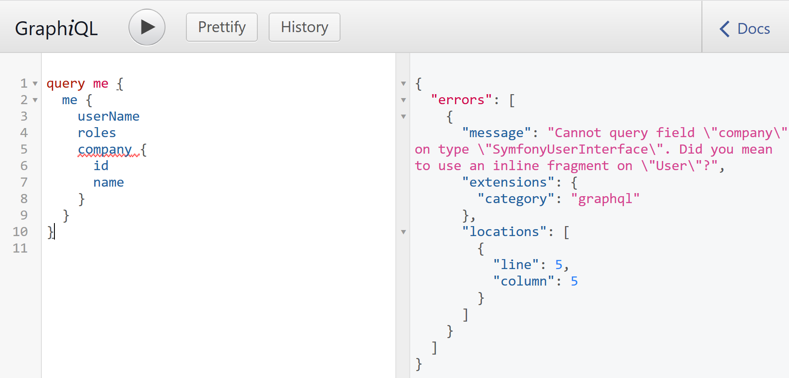
Authentication

Slide 88
Authentication
query me { me { userName roles ... on User { id company { id name } } } }
To access fields from the “User” class you need to use a GraphQL “fragment”. A “fragment” allows you to access fields from implementations from an interface

Slide 89

I WANT THE USER LIST PROTECTED!

Slide 90
Authorization
use TheCodingMachine\GraphQLite\Annotations\Right; class UserController { //… /** * @Query() * @Right("ROLE_ADMIN") * @return ORMQueryResult|User[] */ public function users(?string $search) { return new ORMQueryResult($this->userRepository->search($search)); } }
@Right annotations should be used with @Field too!

Slide 91
Fine grained authorization
Sometimes, you need to grant access to a resource based on complex rules.
For instance:
“I can view only emails from my users in my own company”

Slide 92
Fine grained authorization
/** * @Type() */ class User implements UserInterface, Serializable { //… /** * @Field() * @Security("this.getCompany() == user.getCompany()", failWith=null) */ public function getEmail(): ?string { return $this->email; }
}

Slide 93
Fine grained authorization (using voters)
/** * @Type() */ class User implements UserInterface, Serializable { //… /** * @Field() * @Security("is_granted('email', this)", failWith=null) */ public function getEmail(): ?string { return $this->email; }
}

Slide 94

Fine grained authorization
Notice how security annotations are directly added to the model rather than at the controller level.

Slide 95
WE NEED TO COMPUTE THE VAT!
FOR EVERY PRODUCT! NOW!

Slide 96
Hands on time!
Getting started
Pagination
Authentication / Authorisation
Autowiring
The front-end side
Mutations
Performance

Slide 97
Improving our sample
GraphQLite makes it trivial to compute a "dynamic" field.
In our application, let's add a field to the "Product" type that computes the VAT of a product:
class Product { // … /** * @Field() */ public function getVat(): float { return $this->price * 0.2; } }

Slide 98
Improving our sample
But sometimes, you need extra logic.
Your logic depends on complex services and does not belong to an entity / a model.
You need to access a service from a @Field annotated method in an entity.

Slide 99
Improving our sample
class Product { // … /** * @Field() * @Autowire(for="$vatService") */ public function getVat(VatService $vatService): float { return $vatService->getVat($this); } }

Slide 100
SERVICES IN YOUR MODEL?
ARE YOU KIDDING ME?

Slide 101
Improving our sample
Our getVat method requires directly the VatService class. This is not ideal because our entity is supposed to be independent of any service now depends on an external service.
Our models should be independent of any service. We can reach this independence by using interfaces (dependency inversion principle).

Slide 102
Improving our sample
class Product { // … /** * @Field() * @Autowire(for="$vatService") */ public function getVat(VatServiceInterface $vatService): float { return $vatService->getVat($this); } }

Slide 103
Hands on time!
Getting started
Pagination
Authentication / Authorisation
Autowiring
The front-end side
Mutations
Performance

Slide 104
GraphQL on the client side
There are 2 strategies:
Lightweight client
Full featured client
Simple wrapper around “fetch”
Cache
Typescript types generation…

Slide 105
GraphQL on the client side
There are 2 strategies:
Lightweight client
Full featured client
Urql
FetchQL
GraphQL-Request
Apollo (framework-agnostic)
Relay (React only)

Slide 106

GraphQL on the client side About Relay
Relay is the GraphQL client from Facebook.
It comes with a set of restrictions on the GraphQL schema.
To use Relay, you need a GraphQL server compatible with Relay (like Lighthouse or Overblog/GraphQL-bundle)

Slide 107
Zoom on Apollo
Apollo has bindings with:
Angular
React
VueJS
Svelte
You bundle a React/Angular/Vue component in a Apollo component and Apollo takes in charge the query to the server

Slide 108
GraphQL on the client side – with types!
GraphQL has types.
Typescript has types.
It makes a lot of sense to propagate types from GraphQL to typescript:

Slide 109
GraphQL on the client side – with types!
GraphQL schema (from the server)
Apollo codegen
Typescript interfaces
GraphQL queries (from the client code)

Slide 110
Generating queries and types
$ docker-compose exec front-react yarn run codegen
yarn run v1.16.0
$ graphql-codegen --config codegen.yml
✔ Parse configuration
✔ Generate outputs
Done in 7.30s.

Slide 111
Generating queries and types
query.graphql
query companies($search: String!) { companies(search: $search) { items(limit:10, offset: 0) { id name website } count } }
Apollo codegen
React hooks
const { data, error, loading } = useCompaniesQuery( { variables: { search: props.search } } );

Slide 112
import * as React from 'react'; import {useCompaniesQuery} from '../../generated/graphql'; import CompanyList from './CompanyList'; interface Props { search: string; } const CompanyListContainer: React.FC<Props> = (props: Props) => { const { data, error, loading } = useCompaniesQuery( { variables: { search: props.search } } ); if (loading) { return <div>Loading...</div>; } if (error || !data) { return <div>ERROR</div>; } return <CompanyList data={data} />; }; export default CompanyListContainer;

Slide 113
End-to-end typing
With GraphQLite + Apollo + Typescript, we can propagate types from the server to the client side
This is insanely cool. You get:
Autocompletion in your IDE
Checking of your code at compilation time
Extremely easy refactoring
PHP classes
GraphQL schema
Typescript types

Slide 114
But where is Redux?
Apollo comes internally with its own store.
Redux is really less useful with Apollo and you can simply scrap ~90% of your reducers.
Still useful for niche places (like managing the current logged user)

Slide 115
WHAT IS THE USE OF A MARKEPLACE
IF I CAN’T ADD PRODUCTS?

Slide 116
Hands on time!
Getting started
Pagination
Authentication / Authorisation
Autowiring
The front-end side
Mutations
Performance

Slide 117
Mutations
class ProductController { // … /** * @Mutation() */ public function createProduct(
string $name,
float $price,
int $companyId): Product { $product = new Product($name,
$this->companyRepository->
find($companyId)); $product->setPrice($price); $this->em->persist($product); $this->em->flush(); return $product; } }
Use a mutation to change the state of your application.
Mutations are similar to queries, only the annotation changes.
It means mutations MUST return a value.

Slide 118
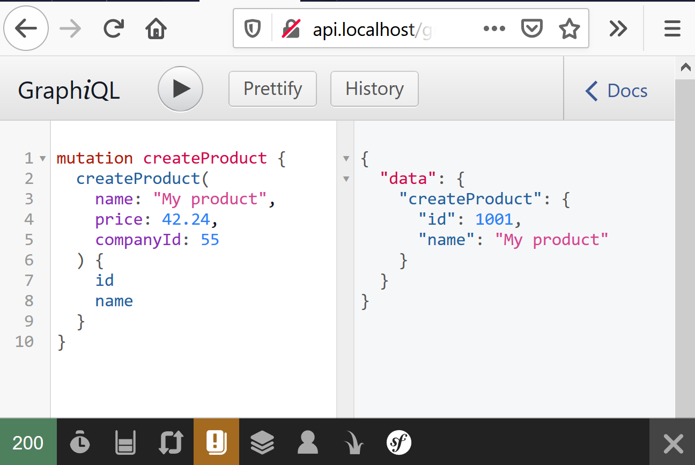
Mutations

Slide 119
Mutations
GraphQLite maps function arguments to the GraphQL model. Therefore, you don’t need any serializer / deserializer!
GraphQLite maps automatically scalar types (int, string, float…)
But it needs some help to map objects passed as arguments.

Slide 120
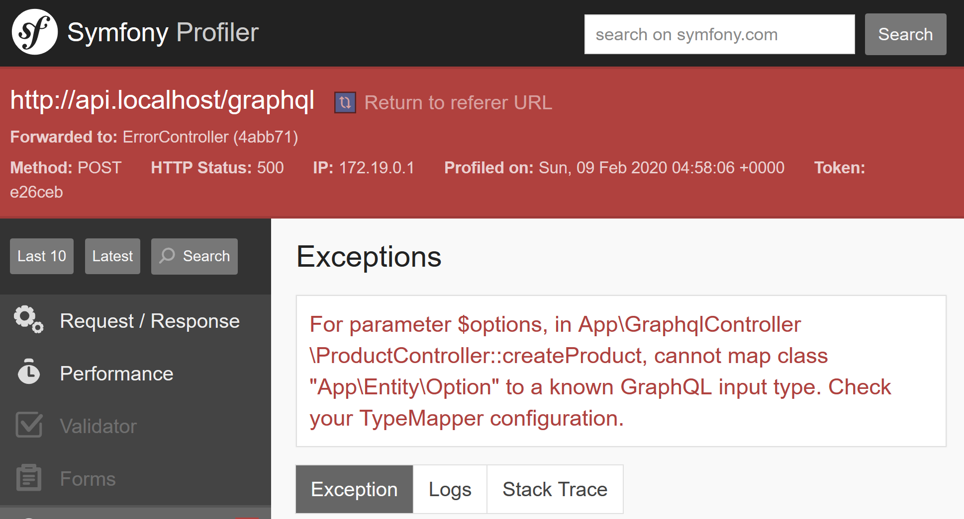
Mutations
/** * @Mutation() * @param Option[] $options */ public function createProduct( string $name, float $price, int $companyId, array $options = []): Product { // … }

Slide 121
Mutations
In GraphQL, objects that are passed in argument to fields/functions are called “input type”.
To define an input type in GraphQLite, we use the @Factory annotation.

Slide 122
Mutations
use TheCodingMachine\GraphQLite\Annotations\Factory; class ProductController { // … /** * @Factory() */ public function optionFactory(string $name, float $price): Option { return new Option($name, $price); } }

Slide 123
PRODUCTS WITH A NEGATIVE PRICE?
ARE YOU KIDDING ME?

Slide 124
Validation

Slide 125
Validation
The GraphQL type system validates automatically the structure of the data passed by our client.
However, the client could still pass garbage data.
Let’s add validation!

Slide 126
Validation
The easiest way to add validation is to throw exceptions if data is not valid.

Slide 127
Validation
/** * @Mutation() * @param Option[] $options */ public function createProduct( string $name, float $price, int $companyId, array $options): Product { if ($name === '') { throw new GraphQLException('Empty product names are not allowed', 400); } if ($price < 0) { throw new GraphQLException('The price must be positive', 400); } // ... }
The easiest way to add validation is to throw exceptions if data is not valid.

Slide 128
Validation
{ "errors": [ { "message": "Empty product names
are not allowed", "extensions": { "category": "Exception" }, "locations": [ { "line": 59, "column": 3 } ], "path": [ "createProduct" ] } ] }
mutation createProduct { createProduct( name: "", price: -12, companyId: 55 ) { id } }
Notes:
This is not perfect, we have 2 violations, but only one error is shown.

Slide 129
Validation
GraphQLite integrates with validation system from Symfony and Laravel.
So validation works differently based on your framework.
In Symfony, GraphQLite relies on the symfony/validator component.
!

Slide 130
Validation
use Symfony\Component\Validator\Constraints as Assert; class Product { /** * @ORM\Column(type="string", length=255) * @Assert\NotBlank() */ private string $name; /** * @ORM\Column(type="float", nullable=true) * @Assert\GreaterThanOrEqual(0) */ private ?float $price; }

Slide 131
Validation
/** * @Mutation() * @param Option[] $options */ public function createProduct( string $name, float $price, int $companyId, array $options = []): Product { // … // Let's validate the product $errors = $this->validator->validate($product); // Throw an appropriate GraphQL exception if validation errors are encountered ValidationFailedException::throwException($errors); // … }

Slide 132
Validation
{ "errors": [ { "message": "This value
should not be blank.", "extensions": { "field": "name", "category": "Validate" }, // ... }, { "message": "This value should be
greater than or equal to 0.", "extensions": { "field": "price", "category": "Validate" }, // ... } ] }
mutation createProduct { createProduct( name: "", price: -12, companyId: 55 ) { id } }
Notes:
This is not perfect, we have 2 violations, but only one error is shown.

Slide 133
Validation
Once again, we managed to push the validation rules on the model layer (instead of keeping them in the controller).
This is great, as these validation rules (like the fact that a price cannot be negative) clearly belongs to the model.

Slide 134
Hands on time!
Getting started
Pagination
Authentication / Authorisation
Autowiring
The front-end side
Mutations
Performance

Slide 135
Performance
Try running this query:
query companies { companies(search: "") { items(limit:100, offset: 0) { id name products { name price vat } } count } }
api_1 | doctrine.DEBUG: SELECT c0_.id AS id_0, c0_.name AS name_1, c0_.website AS website_2 FROM company c0_ WHERE (c0_.name LIKE ? OR c0_.website LIKE ?) AND c0_.id IN (?) ORDER BY c0_.id ASC ["%%","%%",[2701,2702,2703,2704,2705,2706,2707,2708,2709,2710,2711,2712,2713,2714,2715,2716,2717,2718,2719,2720,2721,2722,2723,2724,2725,2726,2727,2728,2729,2730,2731,2732,2733,2734,2735,2736,2737,2738,2739,2740,2741,2742,2743,2744,2745,2746,2747,2748,2749,2750,2751,2752,2753,2754,2755,2756,2757,2758,2759,2760,2761,2762,2763,2764,2765,2766,2767,2768,2769,2770,2771,2772,2773,2774,2775,2776,2777,2778,2779,2780,2781,2782,2783,2784,2785,2786,2787,2788,2789,2790,2791,2792,2793,2794,2795,2796,2797,2798,2799,2800]] [] api_1 | doctrine.DEBUG: SELECT t0.id AS id_1, t0.name AS name_2, t0.price AS price_3, t0.margin AS margin_4, t0.company_id AS company_id_5 FROM product t0 WHERE t0.company_id = ? [2701] [] api_1 | doctrine.DEBUG: SELECT t0.id AS id_1, t0.name AS name_2, t0.price AS price_3, t0.margin AS margin_4, t0.company_id AS company_id_5 FROM product t0 WHERE t0.company_id = ? [2702] [] api_1 | doctrine.DEBUG: SELECT t0.id AS id_1, t0.name AS name_2, t0.price AS price_3, t0.margin AS margin_4, t0.company_id AS company_id_5 FROM product t0 WHERE t0.company_id = ? [2703] [] api_1 | doctrine.DEBUG: SELECT t0.id AS id_1, t0.name AS name_2, t0.price AS price_3, t0.margin AS margin_4, t0.company_id AS company_id_5 FROM product t0 WHERE t0.company_id = ? [2704] [] api_1 | doctrine.DEBUG: SELECT t0.id AS id_1, t0.name AS name_2, t0.price AS price_3, t0.margin AS margin_4, t0.company_id AS company_id_5 FROM product t0 WHERE t0.company_id = ? [2705] [] api_1 | doctrine.DEBUG: SELECT t0.id AS id_1, t0.name AS name_2, t0.price AS price_3, t0.margin AS margin_4, t0.company_id AS company_id_5 FROM product t0 WHERE t0.company_id = ? [2706] [] …
…
…
You will see 1 query to fetch companies and 100 queries to fetch the products!

Slide 136
Performance
Resolver (methods annotated with @Field) are called once per object.
It is very easy to create GraphQL queries that generate a huge number of SQL queries.
!

Slide 137
Performance
A common pattern used by GraphQL servers to avoid the “N+1” queries problem is to use the “data-loader” pattern.
With the "data-loader" pattern, we run only one giant query to fetch the “products”, passing all the IDs in one giant "WHERE ... IN (...)" request.

Slide 138
Performance
class Company { /** * @Field(prefetchMethod="prefetchProducts") * @return Product[] */ public function getProducts($sortedProducts) { return $sortedProducts[$this->getId()] ?? []; } /** * @param Company[] $companies * @Autowire(for="$productRepository") * @return array<int, array<Product>> */ public function prefetchProducts(iterable $companies, ProductRepository $productRepository) { $products = $productRepository->findByCompanies($companies); $sortedProducts = []; foreach ($products as $product) { $sortedProducts[$product->getCompany()->getId()][] = $product; } return $sortedProducts; } }

Slide 139
Performance
class Company { /** * @Field(prefetchMethod="prefetchProducts") * @return Product[] */ public function getProducts($sortedProducts) { return $sortedProducts[$this->getId()] ?? []; } /** * @param Company[] $companies * @Autowire(for="$productRepository") * @return array<int, array<Product>> */ public function prefetchProducts(iterable $companies, ProductRepository $productRepository) { $products = $productRepository->findByCompanies($companies); $sortedProducts = []; foreach ($products as $product) { $sortedProducts[$product->getCompany()->getId()][] = $product; } return $sortedProducts; } }

Slide 140
Performance
class ProductRepository extends ServiceEntityRepository { /** * @param Company[] $companies */ public function findByCompanies(array $companies) { $ids = array_map(function(Company $company) {
return $company->getId();
}, $companies); return $this->createQueryBuilder('p') ->join(Company::class, 'c') ->andWhere('c.id IN (:values)') ->setParameter('values', $ids) ->getQuery() ->getResult() ; } }

Slide 141
Performance
class Company { /** * @Field(prefetchMethod="prefetchProducts") * @return Product[] */ public function getProducts($sortedProducts) { return $sortedProducts[$this->getId()] ?? []; } /** * @param Company[] $companies * @Autowire(for="$productRepository") * @return array<int, array<Product>> */ public function prefetchProducts(iterable $companies, ProductRepository $productRepository) { $products = $productRepository->findByCompanies($companies); $sortedProducts = []; foreach ($products as $product) { $sortedProducts[$product->getCompany()->getId()][] = $product; } return $sortedProducts; } }

Slide 142
Performance
Try running this query again:
query companies { companies(search: "") { items(limit:100, offset: 0) { id name products { name price vat } } count } }
api_1| doctrine.DEBUG: SELECT DISTINCT id_0 FROM (SELECT DISTINCT id_0 FROM (SELECT c0_.id AS id_0, c0_.name AS name_1, c0_.website AS website_2 FROM company c0_ WHERE c0_.name LIKE ? OR c0_.website LIKE ?) dctrn_result_inner ORDER BY id_0 ASC) dctrn_result LIMIT 100 ["%%","%%"] [] api_1| doctrine.DEBUG: SELECT c0_.id AS id_0, c0_.name AS name_1, c0_.website AS website_2 FROM company c0_ WHERE (c0_.name LIKE ? OR c0_.website LIKE ?) AND c0_.id IN (?) ORDER BY c0_.id ASC ["%%","%%",[2701,2702,2703,2704,2705,2706,2707,2708,2709,2710,2711,2712,2713,2714,2715,2716,2717,2718,2719,2720,2721,2722,2723,2724,2725,2726,2727,2728,2729,2730,2731,2732,2733,2734,2735,2736,2737,2738,2739,2740,2741,2742,2743,2744,2745,2746,2747,2748,2749,2750,2751,2752,2753,2754,2755,2756,2757,2758,2759,2760,2761,2762,2763,2764,2765,2766,2767,2768,2769,2770,2771,2772,2773,2774,2775,2776,2777,2778,2779,2780,2781,2782,2783,2784,2785,2786,2787,2788,2789,2790,2791,2792,2793,2794,2795,2796,2797,2798,2799,2800]] [] api_1| doctrine.DEBUG: SELECT p0_.id AS id_0, p0_.name AS name_1, p0_.price AS price_2, p0_.margin AS margin_3, p0_.company_id AS company_id_4 FROM product p0_ INNER JOIN company c1_ WHERE c1_.id IN (?) [[2701,2702,2703,2704,2705,2706,2707,2708,2709,2710,2711,2712,2713,2714,2715,2716,2717,2718,2719,2720,2721,2722,2723,2724,2725,2726,2727,2728,2729,2730,2731,2732,2733,2734,2735,2736,2737,2738,2739,2740,2741,2742,2743,2744,2745,2746,2747,2748,2749,2750,2751,2752,2753,2754,2755,2756,2757,2758,2759,2760,2761,2762,2763,2764,2765,2766,2767,2768,2769,2770,2771,2772,2773,2774,2775,2776,2777,2778,2779,2780,2781,2782,2783,2784,2785,2786,2787,2788,2789,2790,2791,2792,2793,2794,2795,2796,2797,2798,2799,2800]] []
Success! The 100 queries have been turned in a unique query!

Slide 143
Performance
!
Beware! You should always time your queries after applying an optimization!
650ms
time
520ms
Before optimization
After

Slide 144
Data-loader pattern: some problems
The “data-loader” pattern is far from perfect:
Unlike all other features, it puts some GraphQL peculiarities right into your models (not good)
It is not extremely easy to understand
!

Slide 145
Performance: solutions?
The “N+1” problem is not specific to GraphQL.
It is a recurring problem of all ORMs.
The code below triggers “N+1” calls.
$users = $userRepository->findAll(); foreach ($users as $user) { echo $user->getName().' lives in '.$user->getCountry()->getLabel()."\n"; }

Slide 146
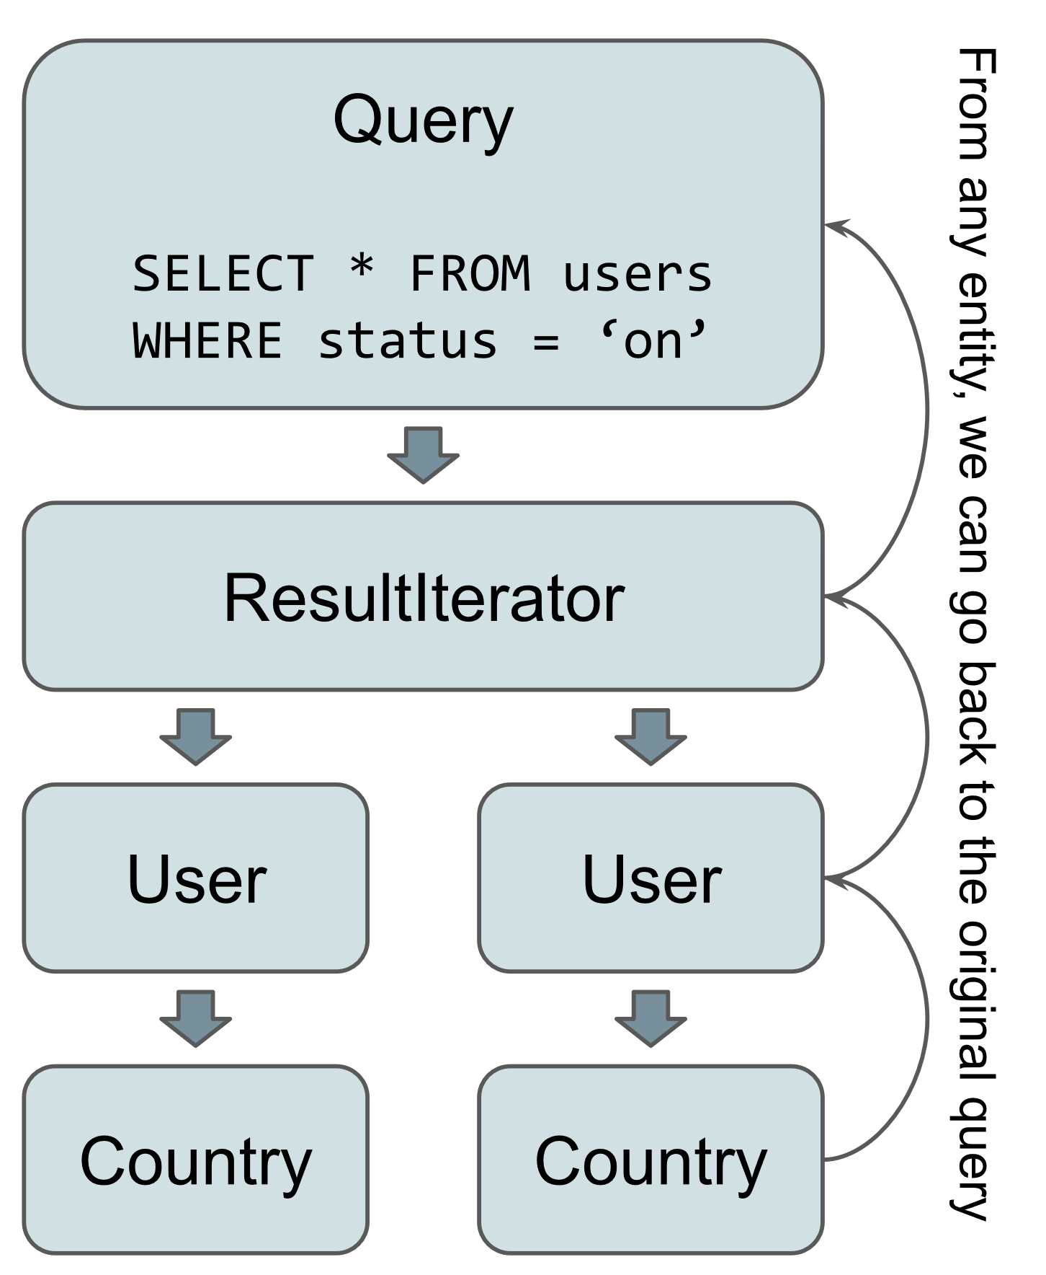
Performance: solutions?
Hot take:
This problem should be solved at the ORM level and not at the GraphQL level!
If from an entity, we could go back to the query that generated it, it would be possible to do “eager lazy loading”.

Slide 147
Performance: solutions?
Doctrine ORM does not support this notion of “eager lazy loading”, but a few ORMs can:
NotORM
Nette Database Explorer
Laravel JIT loader
TDBM 5.3 (work in progress)

Slide 148
More features?

Slide 149
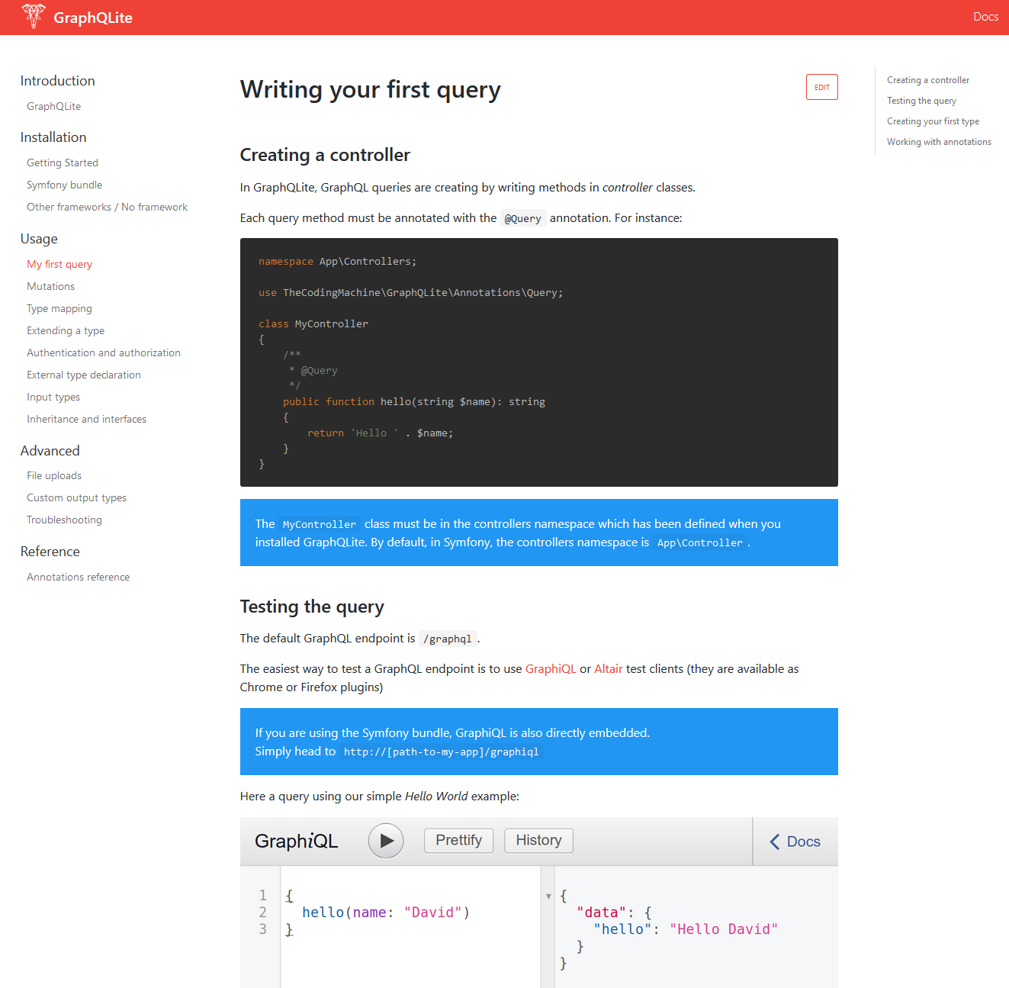
More features!
Enum support
File uploads
Union types
Declaring a type without annotating the PHP class
DateTime type mapping
Inheritance and interfaces
Everything is documented at:
https://graphqlite.thecodingmachine.io

Slide 150
What’s next?
Support for subscriptions (real-time GraphQL)
A simple to use JS client
An ORM that solves natively the N+1 problem

Slide 151
So… GraphQL everywhere?

Slide 152
GraphQL everywhere?
GraphQLite makes it trivial to write a GraphQL API. It is now easier to start a GraphQL API than a REST API! \o/
GraphQL makes a lot of sense for most of our projects because it eases the separation between front-end and back-end
And the tooling in JS/TS is awesome

Slide 153
GraphQL everywhere?
Performance warning! GraphQL itself is fast but…
N+1 problem
It is easy to write slow queries ➔ Warning with front facing websites.
!

Slide 154
GraphQL everywhere?
Two strategies available to avoid the “N+1” problem:
Analyzing the GraphQL query and “joining” accordingly
Or the “data-loader” pattern
But the real answer will come from ORMs
+ a need to set limits on the queries complexity to avoid “rogue” queries

Slide 155




Questions?
David Négrier
@david_negrier
graphqlite.thecodingmachine.io
@moufmouf
More cool stuff:
https://www.thecodingmachine.com/open-source/
https://thecodingmachine.io

